Slide 1
Storytelling Across Multiple Platforms
Heather Carlson

Slide 2
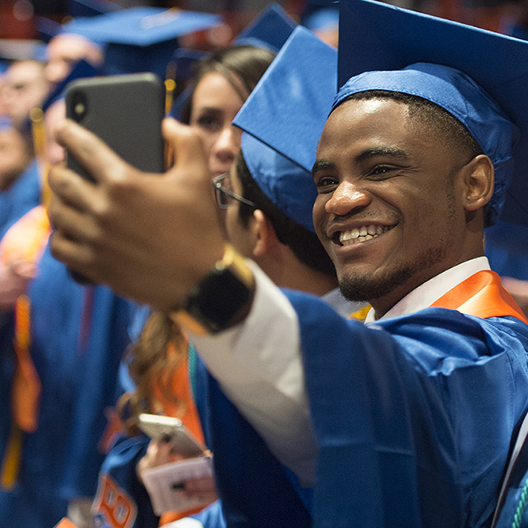
Storytelling matters.
Don’t tell me. Make me feel it.
We think in story. If we don’t feel something, we move on.
When hearing a story that made us feel anything it’s almost 22 times more likely for us to memorize.
Stories were made for digital/social media.
“Tell me a fact, I’ll learn.
Tell me the truth, I’ll believe.
Tell me a story, It’ll live in my heart forever.”
- Indian Proverb

Slide 3
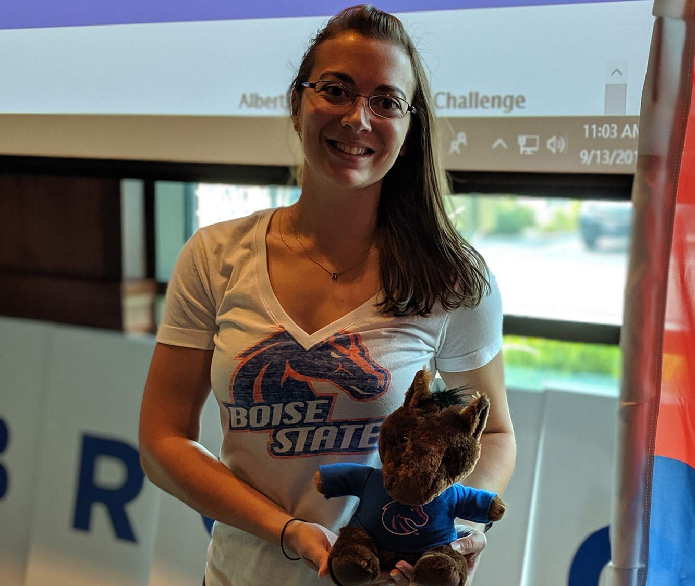
YOUR digital STORY
EMBRACE VISUALS
It’s a visual medium. Embrace photos and videos. Share both at different times.
YOUR digital STORY
YOUR digital STORY
SHOW UNIQUENESS
AUDIENCE-FIRST
Understand your audience on each platform. Tailor messages and timing to these platform-specific metrics.
Social media is quirky, real and authentic. Use that to your advantage. Dollar Shave Club.

Slide 4
YOUR digital STORY
INSIDER EFFECT
Bring your audience behind the scenes. Feature staff, funny office moments, “how the sauce is made.”
YOUR digital STORY
YOUR digital STORY
USER GENERATED CONTENT
BE AUTHENTIC.
It doesn’t have to be professional, it just has to be real.
Don’t be afraid to reshare content created by your audience.

Slide 5
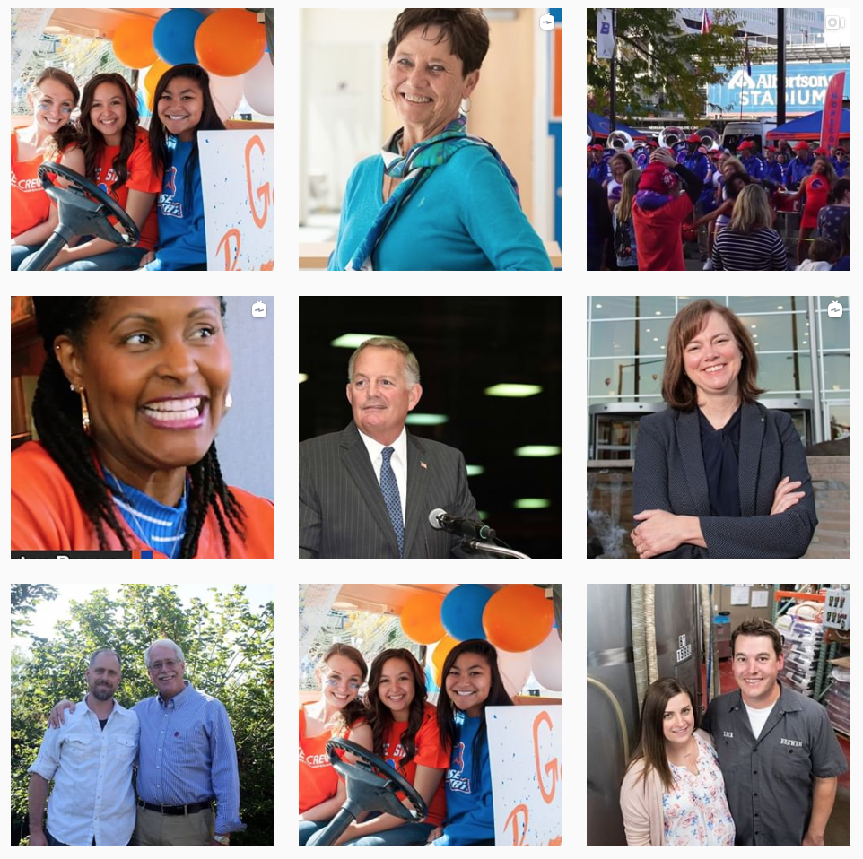
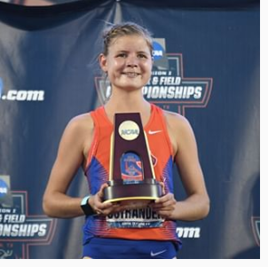
THE MEDIUM MATTERS.
Different platforms have different features — use them all!
Facebook: albums, events, stories, groups, pages, targeted ads
Instagram: stories, IGTV, takeovers, sponsored content, influencers
Twitter: In-the-moment, breaking news, promoted tweets, retweets can go a long way!
LinkedIn: Company pages, showcase pages, excellent for people stories, sponsored content, business and organizational learning

Slide 6
MAXIMIZE YOUR STORYTELLING.
You have audience crossover. Share everywhere.
Share on all platforms.
Share at different times on different platforms throughout the day.
Share story in different ways on the same platform (stories and posts).
Have a plan and schedule!
Monitor. Share. Tweak. Repeat.
Purchase decisions are shaped by two things: stories told and the memories they leave behind.

Slide 7
THANK YOU!
boisestate.edu/alumni • boisestate.edu/giving
facebook.com/boisestatealumni
instagram.com/boisestatealumni
twitter.com/BoiseStateAlum
LinkedIn: Boise State Alumni and Friends

